Slide 1
Unit-3: Nanosensors in agriculture
Nanoparticles, Nanoparticles based nanosensors for agriculture
Nanosensors in pesticide detection in soil
Nanobiosensors – basic principle and characteristics
Nanobiosensors for microbial detection in soil
Practice : Application of sensors for detection of humidity of soil, pesticide residue, nutrient requirement and crop pest identification

Slide 2
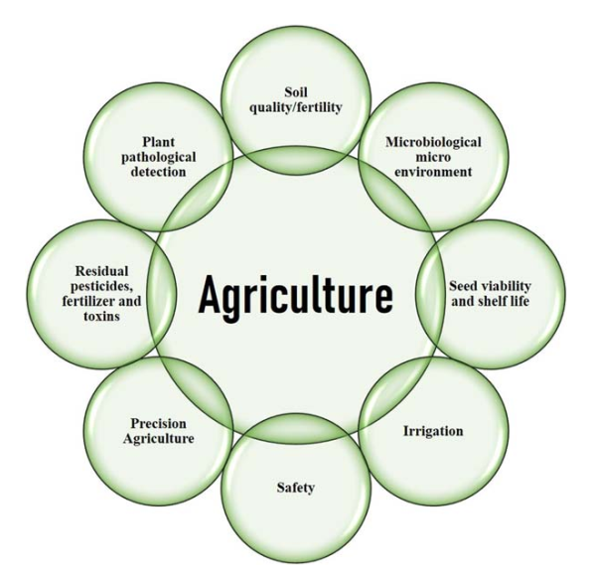

Slide 3
Nanoparticles
Ultrafine particles of matter
Size ranging between 1 and 100 nm
Catalysis, medicine, energy harvesting, agriculture, engineering, and environmental remediation

Slide 4
Nanoparticles
Organic nanoparticles
Inorganic nanoparticles
materials made up of elemental metal, metal oxides, or various metal salts
Carbon-based nanoparticles
high electronic conductivity, extraordinary chemical or electrochemical stability, large surface area

Slide 5
Nanobiosensors
Biosensors
Has biological recognition elements like antibodies, enzyme, deoxyribonucleic acid (DNA), and microorganisms.
Biological recognition elements are coupled with a chemical or physical transducer and can transform a biochemical, biological, or chemical indicator through a quantifiable and processable electrical signal

Slide 6
World Health Organization revealed that more than 26 million human pesticide poisonings occur each year with about 220,000 deaths worldwide

Slide 7
Basic principle and characteristics of nanobiosensors
operational principle of nanobiosensors includes the sample analyte, bioreceptors, transducers coupled with nanostructured materials, and eventually the detectors.

Slide 8
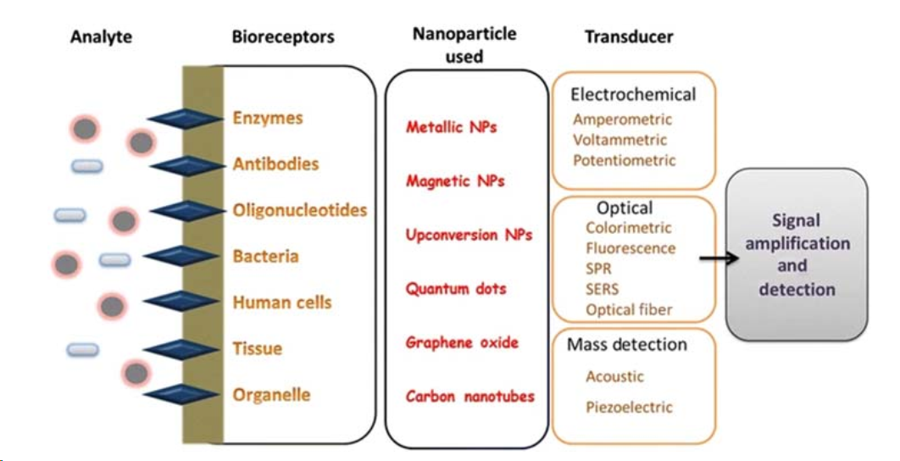
Components of nanobiosensors

Slide 9
Scenario:
To measure glucose levels in blood
Glucose nanobiosensor
Gold nanoparticles as the nanomaterial
Glucose oxidase enzymes – Bioreceptors
bind to glucose molecules and produce hydrogen peroxide as a byproduct
Transducer – Electrochemical sensor

Slide 10
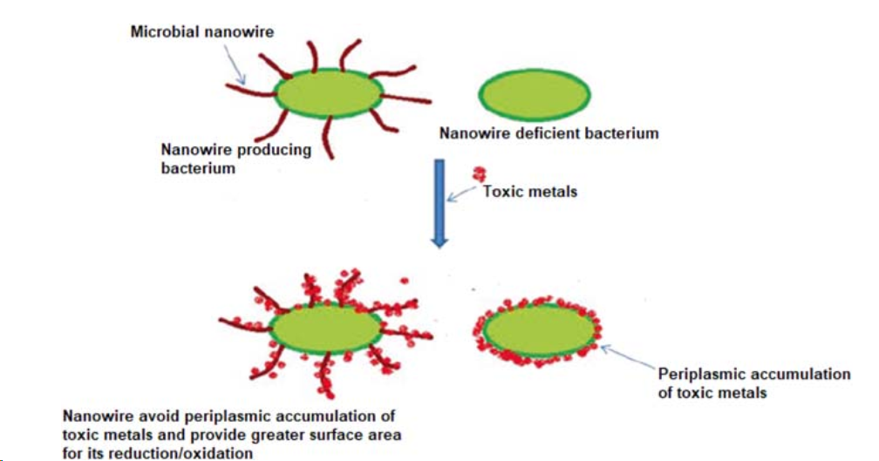
Microbial detection

